Slide 1



Ensemble Models
INTRODUCTION TO MACHINE LEARNING
- Ashwina Rakish

Slide 2
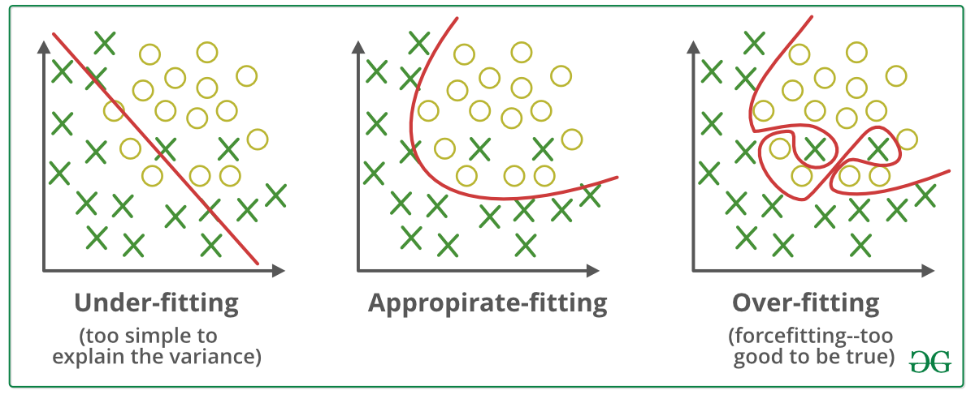
Underfitting and Overfitting
Underfitting: Underfitting refers to a scenario where a model is unable to capture the underlying patterns of the data, typically because it's too simplistic or lacks the necessary complexity to adequately represent the relationships between the features and the target variable.
Overfitting: Overfitting arises when a model learns to perform exceptionally well on the training data but fails to generalize to new, unseen data due to capturing noise or random fluctuations present in the training set.

Slide 3
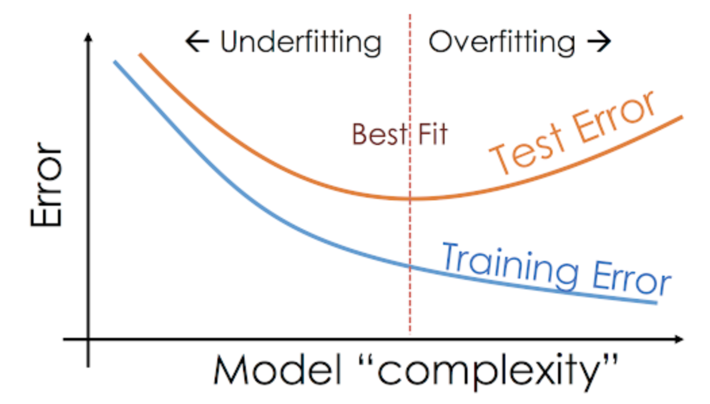
Error Increases?!
When the model starts overfitting the training data, it gets too specific about the specific patterns or trends observed in the training data, and performance degrades on the test data. Model is less generalized and becomes too specific.

Slide 4
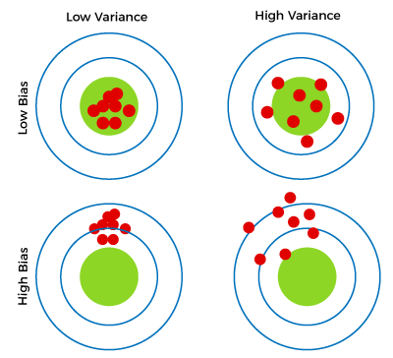
Bias and Variance
Bias : Bias refers to the error introduced by approximating a real-world problem with a simplified model. It represents the difference between the average prediction of our model and the true value we are trying to predict.
Variance : Measures the spread of predicted data or rather, how much the model predictions change for small fluctuations.

Slide 5
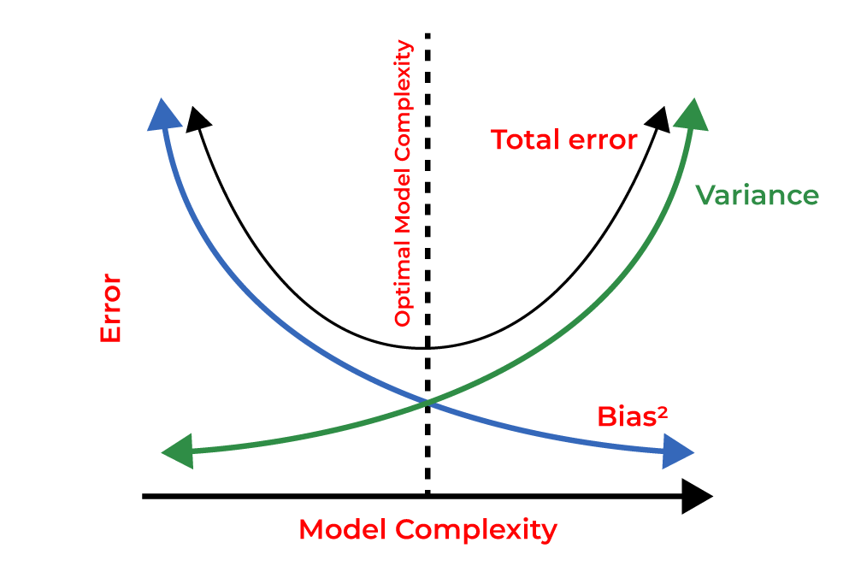
Bias Variance Trade-off
If the algorithm is too simple, then it may be on high bias and low variance condition and thus is error-prone. If algorithms fit too complex, then it may be on high variance and low bias. An optimal complexity if found which gives us a reasonable bias and variance

Slide 6
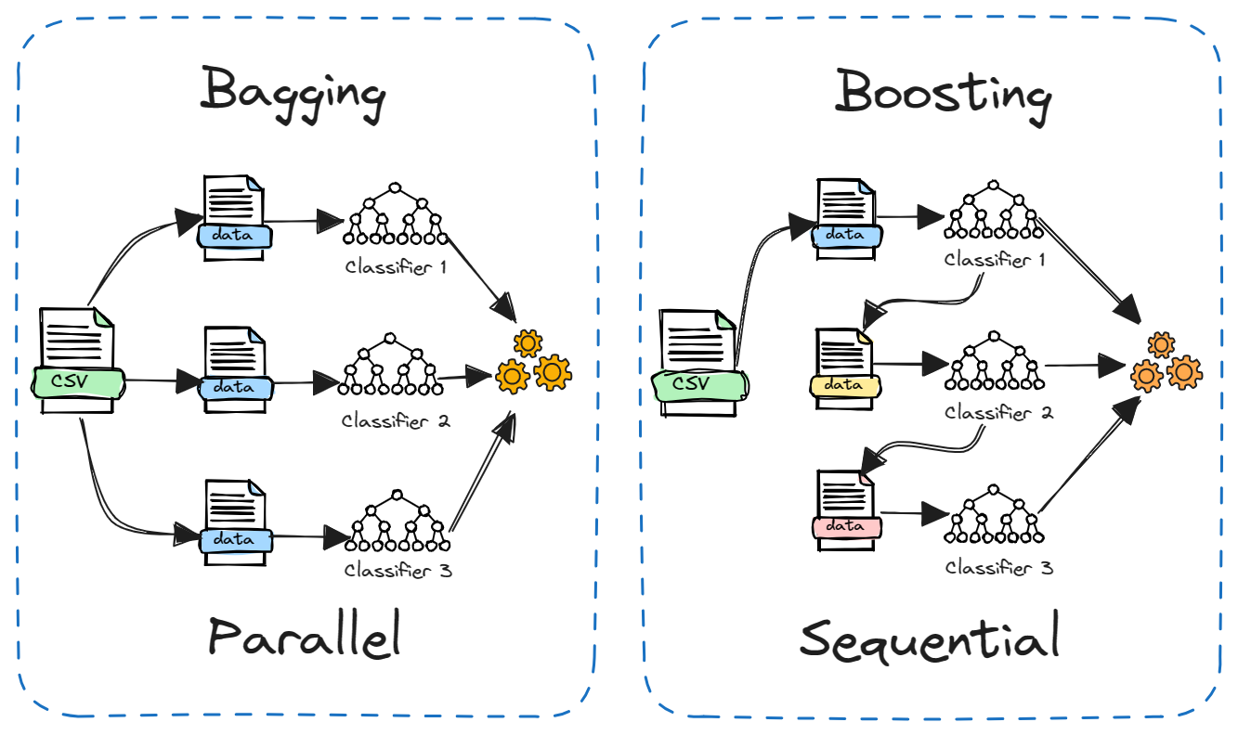
Ensemble Models
Ensemble models combine predictions from multiple individual models to improve overall performance and robustness in predictive tasks. By aggregating the predictions of these models, ensemble methods aim to improve overall predictive accuracy and robustness compared to any single model.

Slide 7
Ensemble Models
Bagging (Bootstrap Aggregating) involves training multiple models independently on different subsets of the training data (sampled with replacement), and then aggregating their predictions to produce a final output, thereby reducing variance and improving stability.
Boosting sequentially trains multiple models, where each subsequent model focuses on correcting the errors made by the previous ones, resulting in a strong learner. This technique aims to reduce bias and improve predictive accuracy by emphasizing hard-to-predict instances.

Slide 8
QUIZ

Slide 9
Question: Does bagging help reduce bias or variance?
Answer: Variance

Slide 10
Question: Does bagging prevent overfitting or underfitting?
Answer: Overfitting

Slide 11
Question: Does boosting reduce bias or variance?
Answer: Bias

Slide 12
Question: Does boosting prevent overfitting or underfitting?
Answer: Underfitting

Slide 13
Question: How do you know if the model is overfitting?
Answer: Plot testing error.

Slide 14
Question: Can my model have high bias and high variance?
Answer: No, as variance increases bias decreases.

Slide 15
Question: What bias and variance is ideal?
Answer: Low Bias and Low Variance(but this never happens)

Slide 16
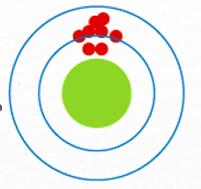
Question: What bias and variance does this have?
Answer: High Bias and Low Variance

Slide 17
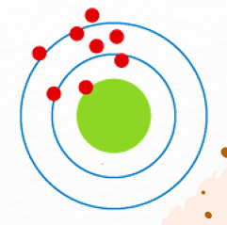
Question: What bias and variance does this have?
Answer: High Bias and High Variance

Slide 18
Thank You!

